Slide 1
Short History and Financial Euphoria of Token Economics
By Dimitri Chupryna

Slide 2
Speculative Episode

Slide 3
Speculative Episode: Common Denominators
“There is something new in the world”
Financial innovation (in one form or another, creation of debt)
LEVERAGE!

Slide 4
1700s: South Sea Bubble
South Sea Company is a monopoly. 1000% stock gain
Introduction of joint-stock companies
Massive selling stock in promise of future revenues

Slide 5
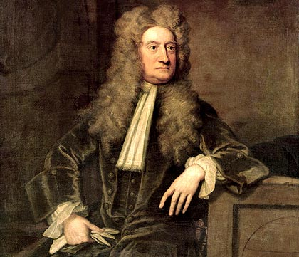
Physicist, Not a Trader
Isaac Newton: “I can measure the weight of celestial bodies but I cannot measure depths of human folly.”
Lost 20,000 pounds speculating ($1m today)
REKT!

Slide 6
1800s: Bank Mania in the United States

Slide 7
1800s: Bank Mania in the US
Fractional reserve banking
New England bank found bankrupt: $500,000 banknotes issued for $86 in reserve

Slide 8
Blockchain, This Time It’s Different?

Slide 9
Bitcoin: Perfect Bubble?
Fixed, deflationary supply
Exponential demand growth
Classical markets can adjust supply
Prices trend towards equilibrium

Slide 10
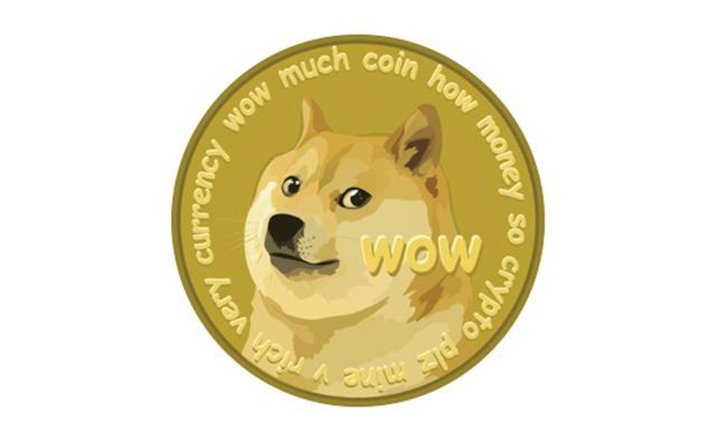
2013, 2014: Renaissance
New versions of blockchains, mostly copies of Bitcoin
Litecoin, Dogecoin, Namecoin

Slide 11
Ethereum: Super Computer

Slide 12
Ethereum
Smart contracts
Token issuance
Monetize any business model?

Slide 13
Initial Coin Offering: Mother of All Bubbles?
Distributed crowdfunding
Over 1500 ICOs up to date
$20-50m standard size today

Slide 14
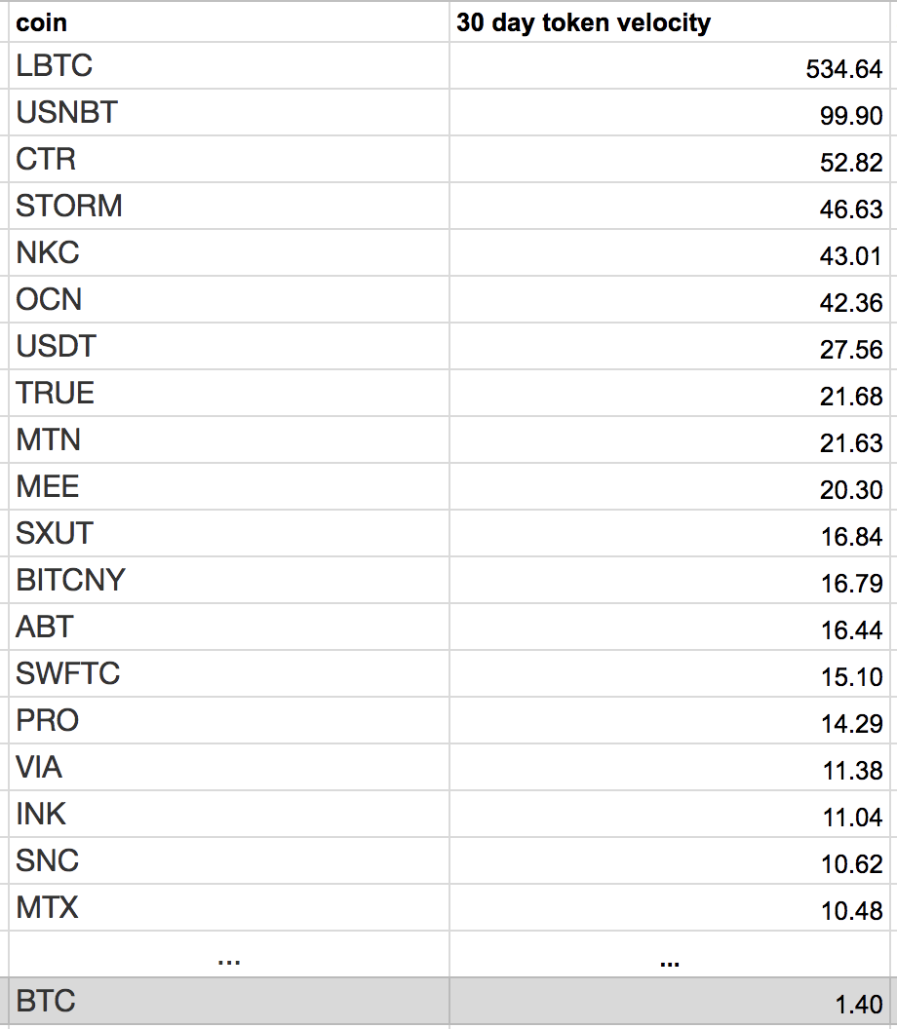
Speculative Magnitude
Average token/cryptocurrency 30 day velocity = 2-3
Bitcoin 30 day velocity = 1.4

Slide 15
Tokenized Securities: $100,000,000,000 problem

Slide 16
Leverage
Total bitcoins circulating: 16998237 (price today: $9088)
Total cryptocurrency market cap: $394,515,654,414 (BTC equivalent = 43,410,613)
So, leverage is….?

Slide 17
Leverage Today = 2.55x

Slide 18
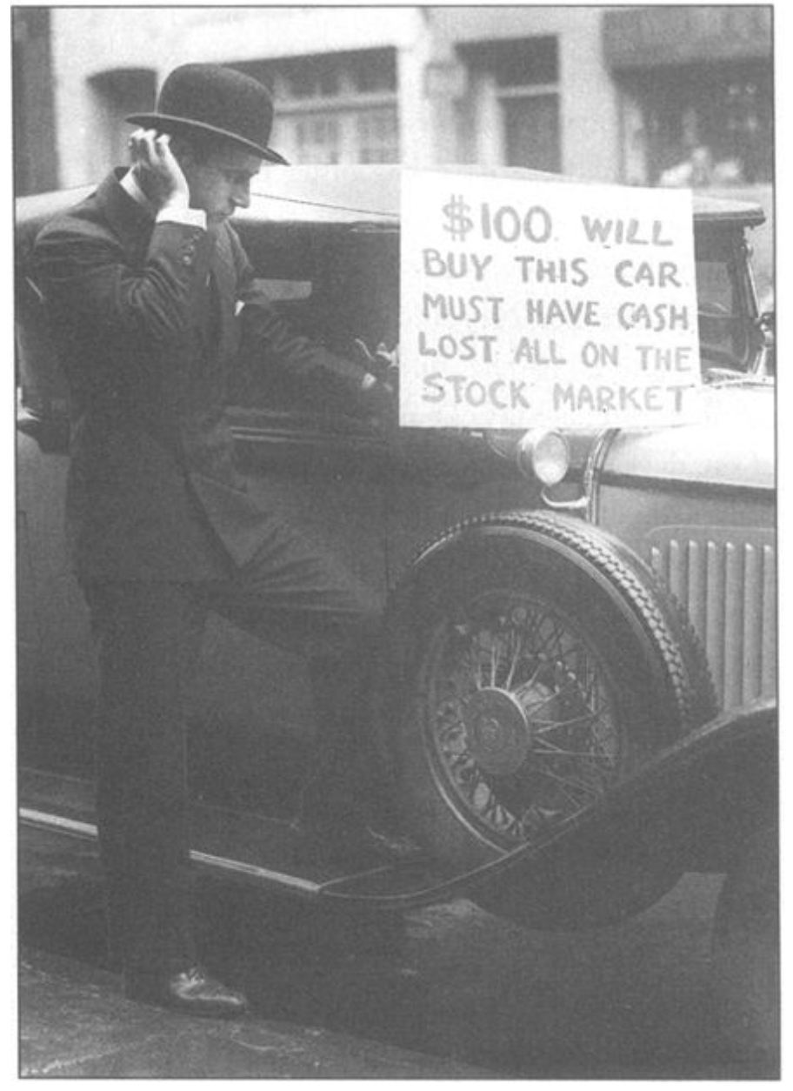
Oldest Rule of Wall Street:
“Financial Genius is Before the Fall”

Slide 19
Thank you
dimitri@taas.fund

